Slide 1
Shell Scripting
A shell script is a list of commands in a computer program that is run by the Unix/Linux shell.
Uses of shell scripting
Shell script helps in doing work which is repetitive in nature. For example: When executing a bunch of commands, often, shells can take all these commands directly from a stored file and execute it, instead of writing them again every time.
They are used to get routine backups by admins.
We can transfer the shell script to other UNIX and similar operating systems and execute.
Shell scripts are also used to monitor systems regularly.
With the help of shell scripts, we can directly interact with the operating system, control the processes running in the system, terminate multiple processes and execute multiple processes at the same time, monitor the process with different metrics such as memory, CPU usage.

Slide 2
Shell - It is the outermost layer of the operating system. It is a special user program which acts as an interface between user and the kernel. It interacts with user and interprets to machine understandable language.
Characteristics of shell
Reading input and parsing command line
Evaluating special character
Setting up pipes, redirection and background processing
Setting up programs for execution
Kernel - Kernel is the heart and core of an Operating System that manages operations of computer and hardware. It acts as a bridge between the user and the resources of the system by accessing various computer resources like the CPU, I/O devices and others. Kernel directly interacts with the hardware by accepting machine understandable language from the shell.

Slide 3
Types of shell
Bourne shell – It’s known as sh shell. developed by Stephen Bourne. It’s implemented in Unix version 7 in 1979.
Bash shell – It’s the default shell for many unix distributions.
Cshell – developed by bill joy. It’s developed in c language. It’s a command processor and runs in a command window.
Korn shell (ksh) – developed by David korn.
Fish shell – developed in 2005. It’s user friendly.

Slide 4
Steps to create shell script
Create a shell script a file using a vi editor or any other editor. Give the file name with extension .sh
Start the script with the shebang line - #!/bin/bash
Write the required commands and save file.
Execute the script by typing the command sh filename.sh

Slide 5
Variables
It’s a named allocation which is used to store the data and it can be changed n number of times during execution.
Note:
Variables name cannot be reserved words.
They cannot have space between them
Variables cannot have special characters
First character of a variable cannot be a number
Types of variable:
1. User defined variable – variable created by the user.

Slide 6
Example:
Addition of 2 numbers
Nano addition.sh
#!/bin/bash
a=14
b=2
echo “value of a is $a”
echo “value of b is $b”
Sum=$($a+$b))
Echo $sum
Run the file – sh addition.sh

Slide 7
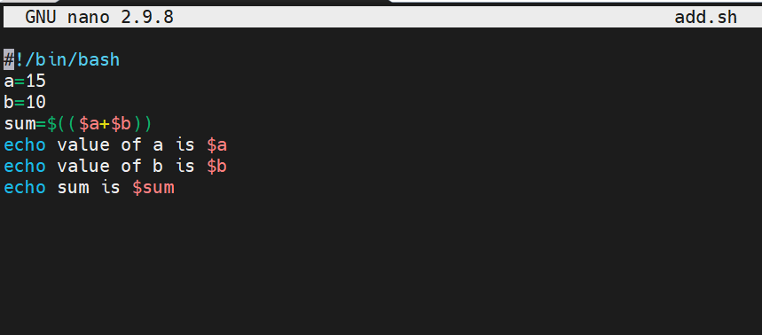
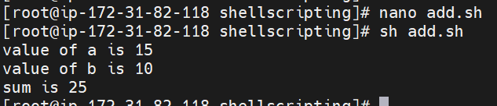

Slide 8
Expressions
Arithmetic operators – used to perform arithmetic operations
( +, - , *, /, =, ==, !=)
Logical operators
-eq – equality condition
-ne – not equal
-gt – greater than
-ge – greater than or equal to
-lt – less than
-le – less than or equal to

Slide 9
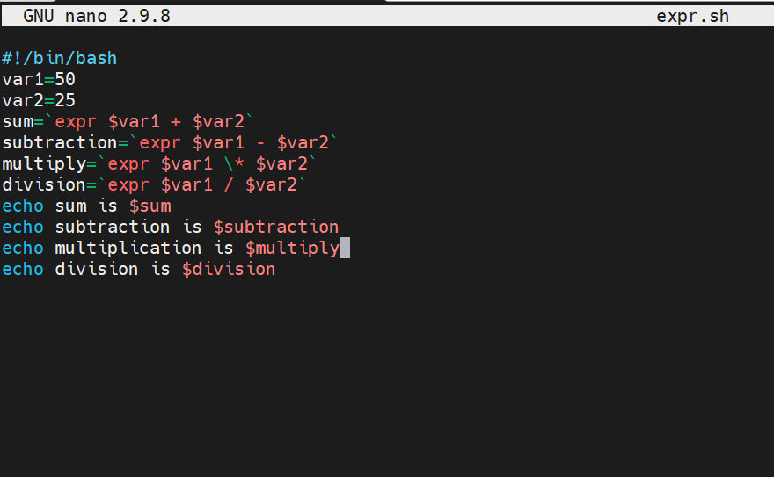
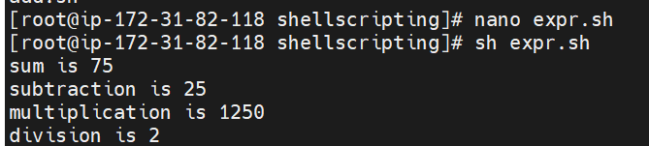
Example:

Slide 10
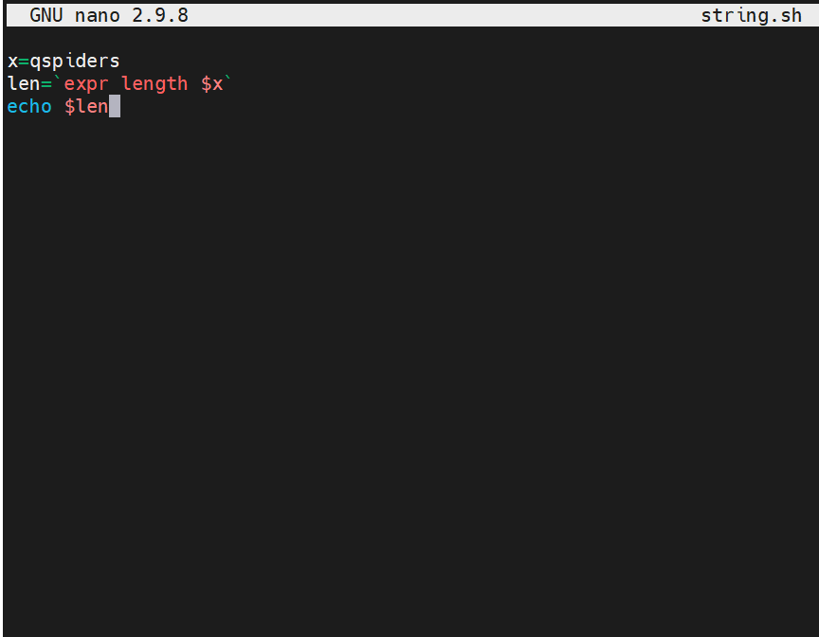

String operation
To count the number of characters
Example:

Slide 11
System defined variables
echo $pwd
echo $home
echo $hostname
echo $hostype
Environment variables
Readonly – When the variable is declared as readonly, it is not possible to change its value.
a=10 => value of a is stored in a
echo $a => print the value of a
readonly a => convert the variable a into readonly
a=5 => modify the value of a
echo the value of a is $a => print the value of a

Slide 12
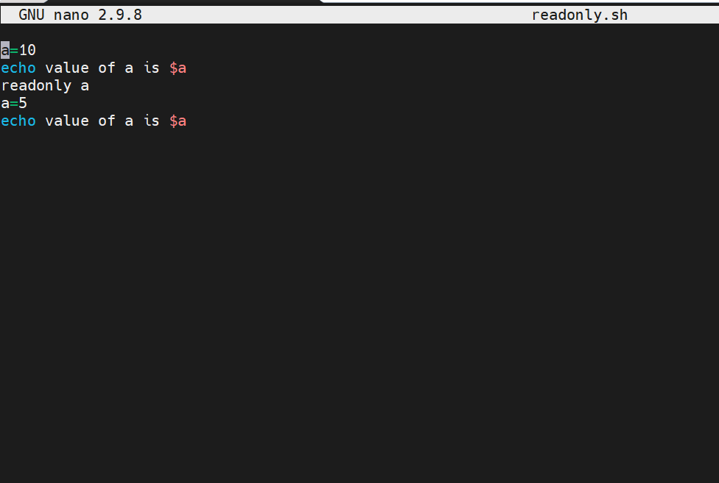


Slide 13
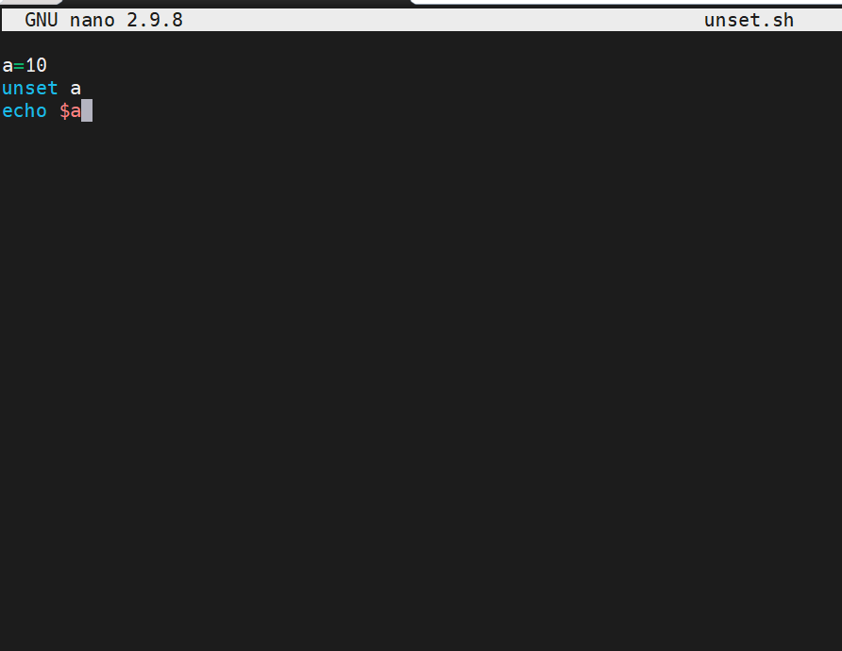

unset

Slide 14
Multi line print
echo "hello \
everyone \
welcome to skillrary \ “
2. Give the space between the data
echo -e "welcome \t to \t skillrary"
-e :- is special operator to do the specific task based on the user input (modify the data)
\t :- give the space between the data

Slide 15
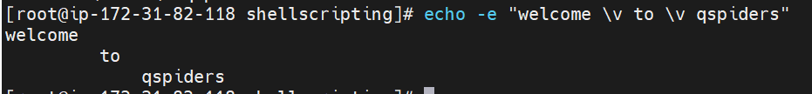
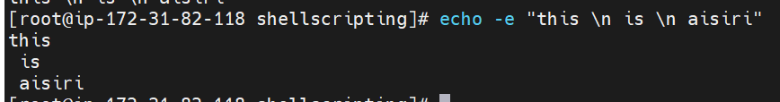
3. To Print the data in vertical format
echo -e "welcome \v to \v qspiders“
4. To print the data line by line :
echo -e "Hello \n everyone \n this is \n aisiri "

Slide 16
Looping statements
For loop
The for loop operate on lists of items. It repeats a set of commands for every item in a list.
Syntax : for var in list
do
command 1
command 2
done
In the above for loop syntax, for, do, and done are built-in keywords.

Slide 17
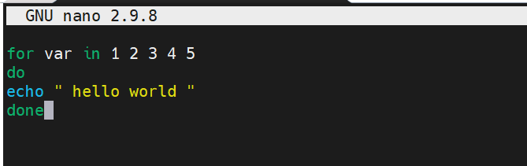
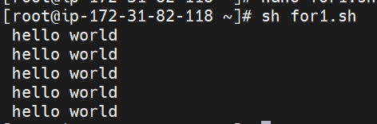
Example : To print hello world 5 times
for var in 1 2 3 4 5
do
echo “hello world”
done

Slide 18
2. While loop
Here the condition is evaluated and based on the result loop will executed, if command raise to false then loop will be terminated .
Syntax :
while [ condition ]
do
command1
command2
done
In the above syntax, initially, the condition will be evaluated if it is true then the commands inside the loop will execute until the condition remains true else it will come outside of the loop. Here while, do, and done are built-in keywords.

Slide 19
Example: To print the numbers in reverse order
i=10
while [[ $i -ge 0 ]]
do
echo $i
((i--))
done

Slide 20
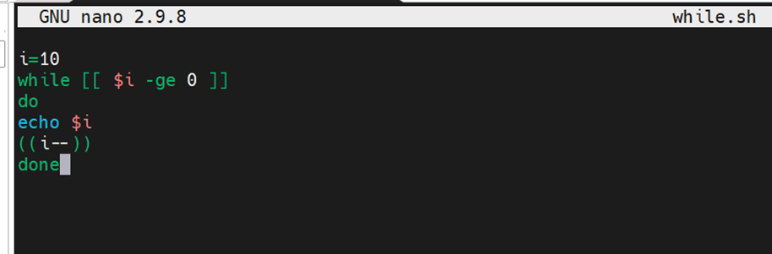
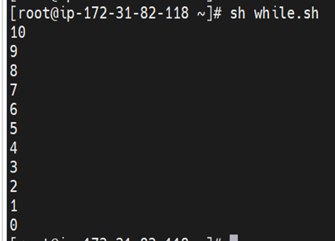

Slide 21
3. Until loop
it will execute the body of the loop until the conditional statement becomes true .
Syntax:
until [ conditional statement ]
do
command1
command2
done

Slide 22
Example : To print the numbers from 5 to 15
i=5
until [[ $i -eq 15 ]]
do
echo $i
((i++))
done

Slide 23
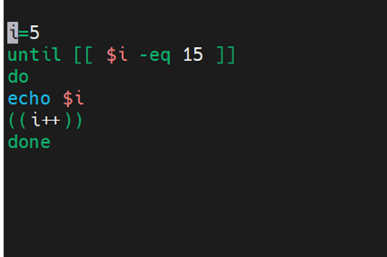
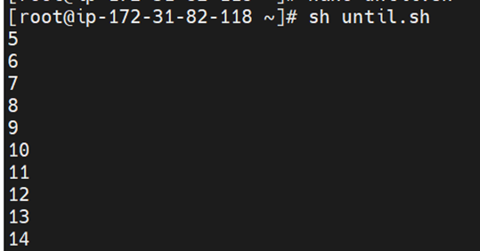

Slide 24
Conditional statements
If condition
In if condition, the set of statements is executed if the condition is satisfied, else the statements will not be executed.
Syntax:
if [ condition ]
then
#set of statements
fi

Slide 25
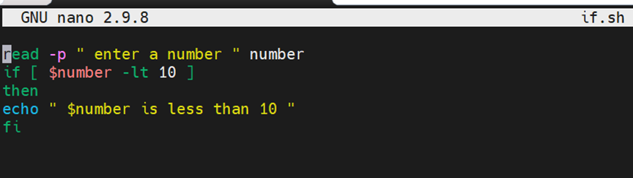

Example:
read -p “enter a number” number
if [ $number -lt 10 ]
then
echo $number is less than 1o
fi

Slide 26
2. if-else
This condition executes set of statements if the condition is true, and another set of statements if the condition is false.
Syntax:
if [ condition ]
then
#set of statements if the condition is true
else
#set of statements if the condition is false
fi

Slide 27
Example:
read -p “ enter a number “ number
if [ `expr $number % 5` == 0 ]
then
echo “ $number is divided by 5”
else
echo “ $number is not divided by 5 “
fi

Slide 28
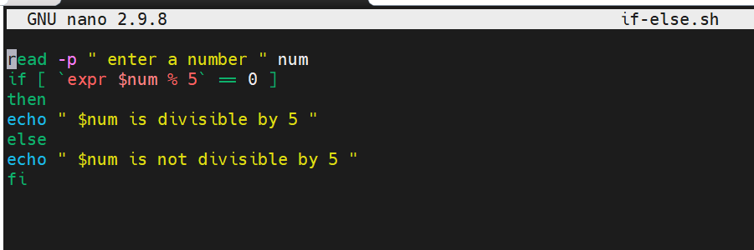
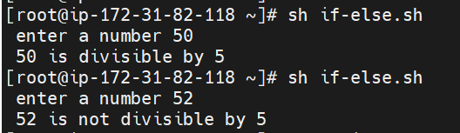

Slide 29
else-if
To use multiple conditions in one if block
Syntax:
if [ condition ]
then
#set of statements
elif [ condition ]
then
#set of statements
else
#set of statements
fi

Slide 30
Example:
read -p “ enter two numbers “ a b
if [ `expr $a % 5` == 0 ]
then
echo “ $a is divisible by 5 “
elif [ `expr $a % 5` == 1 ]
then
echo “$a is not divisible by 5”
fi

Slide 31
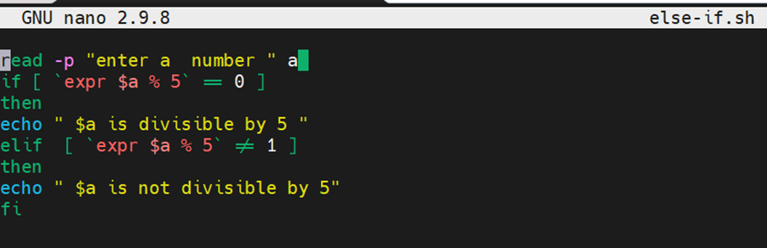
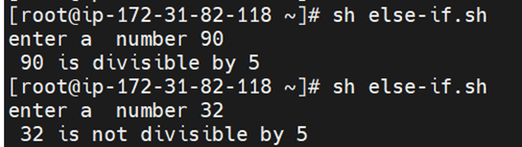

Slide 32
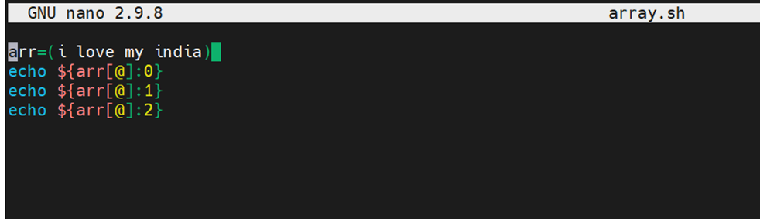
3. Array
An array is a collection of similar type of data stored in a contiguous memory location.
Syntax: array_name = (value1..valuen)
Example 1:
#!/bin/bash
arr=(i love my india)
echo ${arr[@]:0}
echo ${arr[@]:1}
echo ${arr[@]:2}

Slide 33
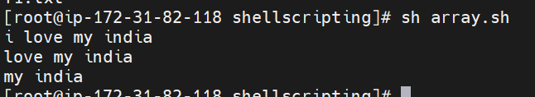
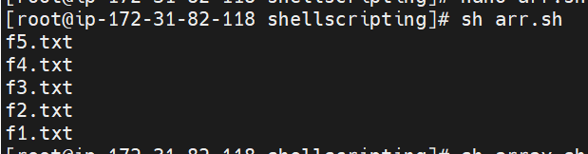
Example 2:
files=("f1.txt" "f2.txt" "f3.txt" "f4.txt" "f5.txt")
echo ${files[4]}
echo ${files[3]}
echo ${files[2]}
echo ${files[1]}
echo ${files[0]}

Slide 34
2. case-esac
Switch case is represented using keywords case and esac which will do multilevel branching. Switch case will need an expression which it needs to evaluate and need to perform multiple operations based on the outcome of the expression.
Example 1:
echo “ Enter the number “
read week
case $week in
1)
echo “ Sunday “
;;
2)
Echo “ Monday”
;;

Slide 35
3)
echo “ Tuesday “
;;
4)
echo “Wednesday”
;;
5)
echo “Thursday”
;;
6)
Echo “Friday”
;;

Slide 36
7)
echo “ Saturday”
;;
*)
echo “ invalid number”
;;
esac

Slide 37

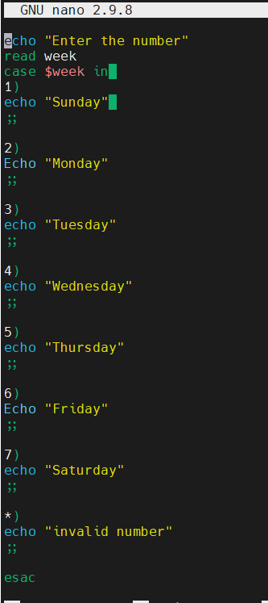
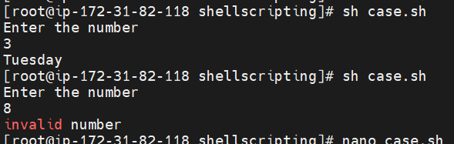

Slide 38
Example 2:
read -p "enter a operation " opr
case $opr in
+)
read -p "add the value for a" a
read -p "add the value for b" b
echo addition of a and b is `expr $a + $b`
;;
-)
read -p "add the value of x " x
read -p "add the value of y " y
echo the subtraction of x and y is `expr $x - $y`
;;

Slide 39
/*)
read -p "add the value of c " c
read -p "add the value of d " d
echo the mul of c and d is `expr $c \* $d`
;;
\)
read -p "add the value of e " e
read -p "add the value of f " f
echo the division of e and f is `expr $e / $f`
;;
*) echo "the operation is not exist"
;;
esac

Slide 40
Functions:
A function is a collection of statements that execute a specified task. Its main goal is to break down a complicated procedure into simpler subroutines that can be used to accomplish the more complex routine.
For the following reasons, functions are popular:
Assist with code reuse.
Enhance the program’s readability.
Modularize the software.
Allow for easy maintenance.
Syntax:
function_name(){
// body of the function
}
The function_name can be any valid string and the body can be any sequence of valid statements in the scripting language.

Slide 41
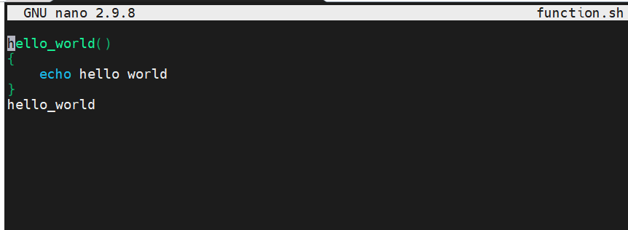

Example:
hello_world()
{
echo hello world
}
hello_world

Slide 42
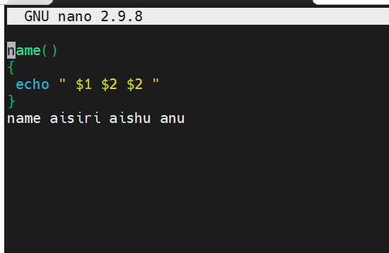
Passing the arguments
Example:
name()
{
echo “ hello $1 $2 $3”
}
name aisiri aishu anu

Slide 43
Local and global variables
A local variable is a special type of variable which has its scope only within a specific function or block of code. Local variables can override the same variable name in the larger scope.
Example 1:
getNum()
{
num=100 #local variable
echo "$num - inside function"
}
echo "$num - outside function"
getNum

Slide 44
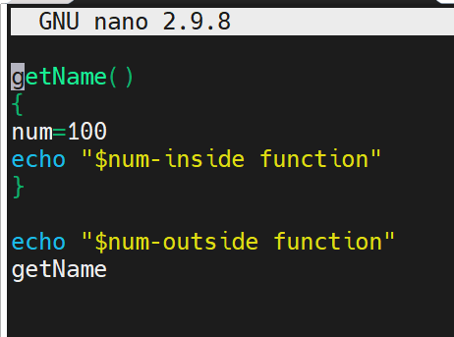

In this example, num is a local variable because it is within the getNum() function. When we are accessing the value of it from the function itself, then we are getting it, but when we are trying to access the same from outside the function, it is not visible.

Slide 45
Example 2:
pkg=nginx
install()
{
echo “installing $pkg”
echo “${FUNCNAME}”
}
config()
{
pkg=tomcat
echo “config $pkg”
}
install
config

Slide 46
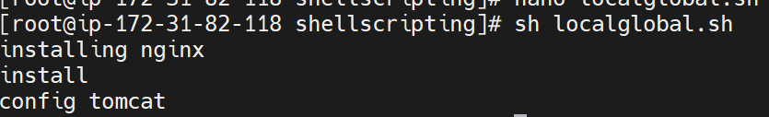
A global variable is a variable with global scope. It is accessible throughout the program. Global variables are declared outside any block of code or function.
Example –
name=qspider #global variable
getName(){
echo "$name (from function)"
}
echo "$name - (outside function)"
getName

Slide 47
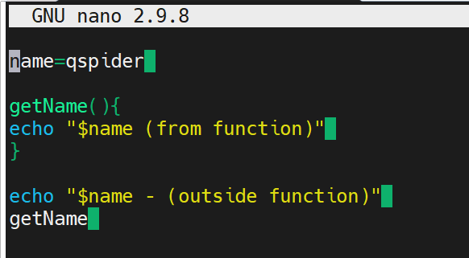

Here, the variable is declared outside the function. It makes the variable a global variable that has its scope all over the program. Thus, it can be accessed from inside or outside a function.

Slide 48
File reading functionality
if we have to read a file, we would need to use a keyword read and hence this while is known as read while loop. The main property is the ability to read line by line when you use the keyword read.
Syntax:
while read variable do <commands to be executed> done <<filename>
The initialization is outside the while loop
Example:
read –p “enter the filename:” file
while read line
do
echo hello world/ $line
done < $file

Slide 49
Counting characters, lines and words in a file
Example:
echo " enter the file name"
read file
c=`cat $file | wc -c`
w=` cat $file | wc -w`
l=` grep -c "." $file
echo " number of characters $c"
echo " number of words $w"
echo " number of lines $l"

Slide 50
